Slide 1
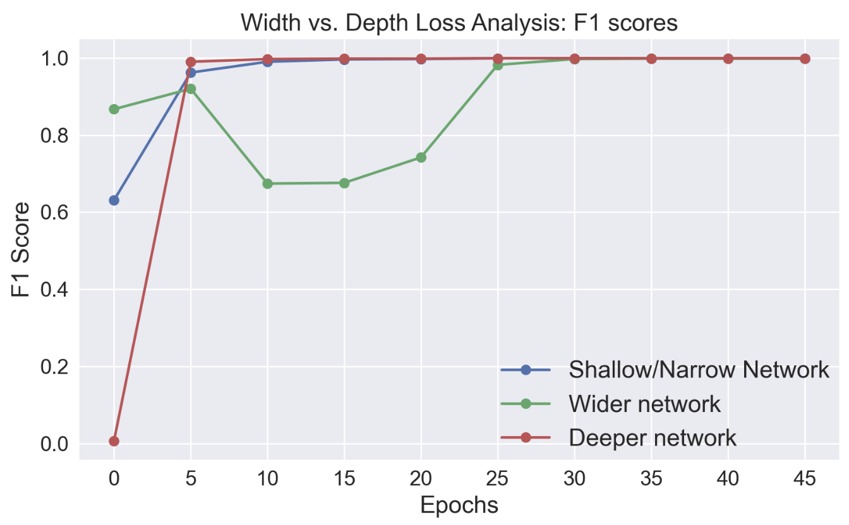
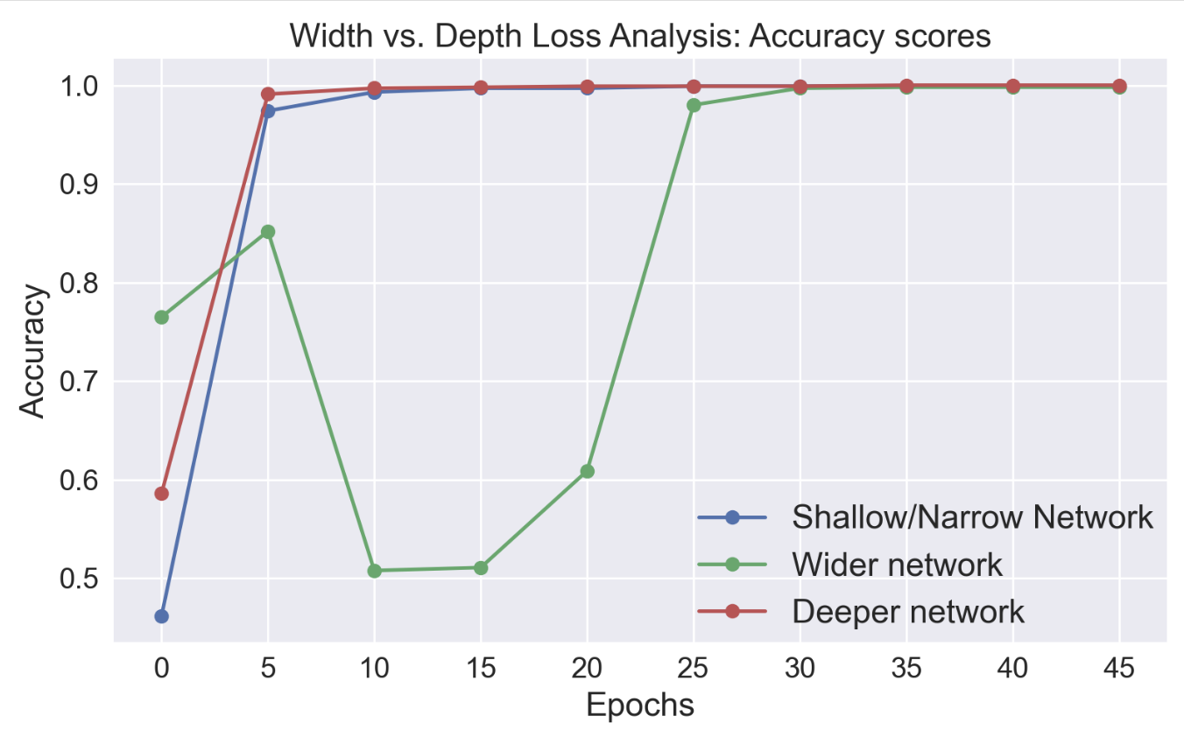
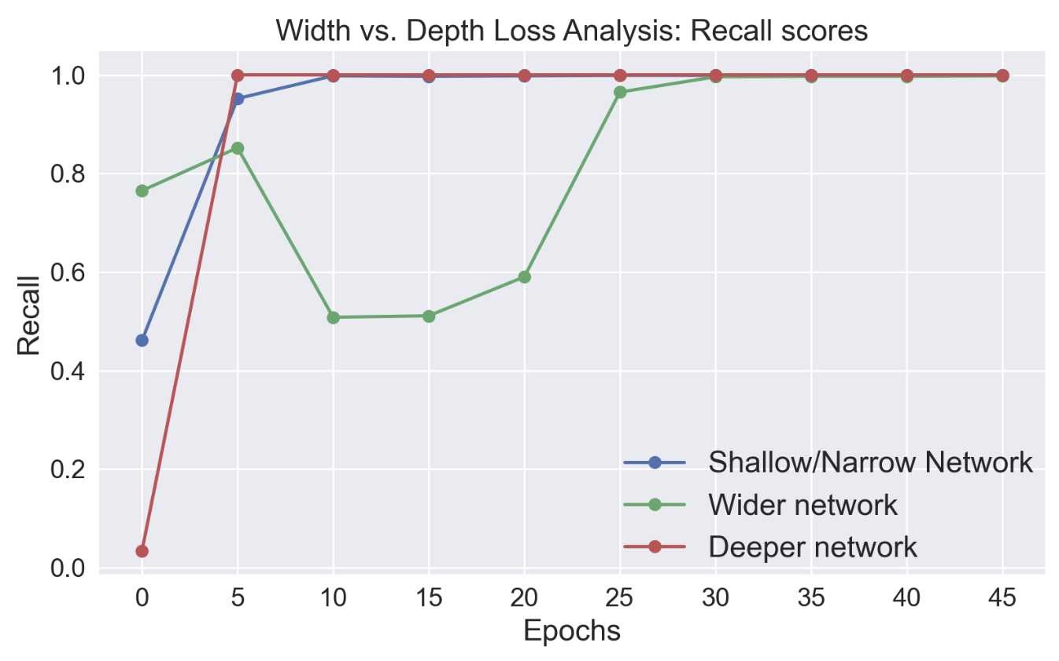
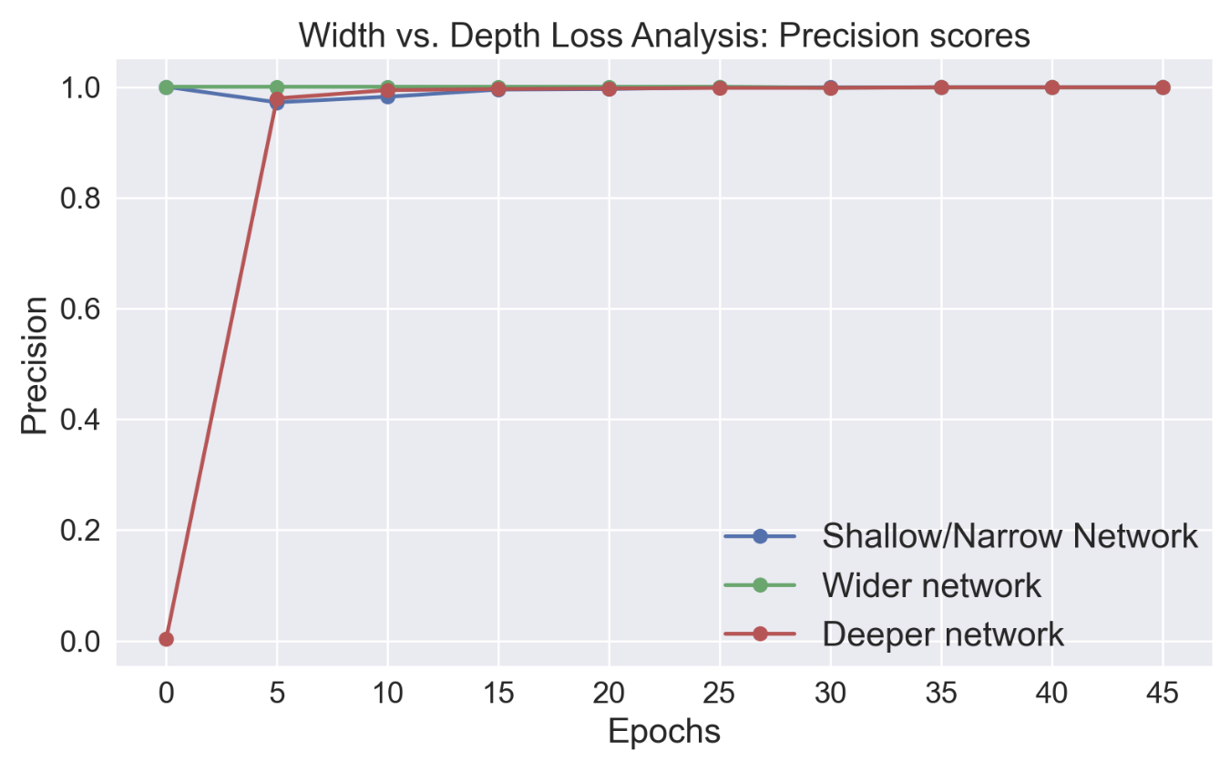

Slide 2
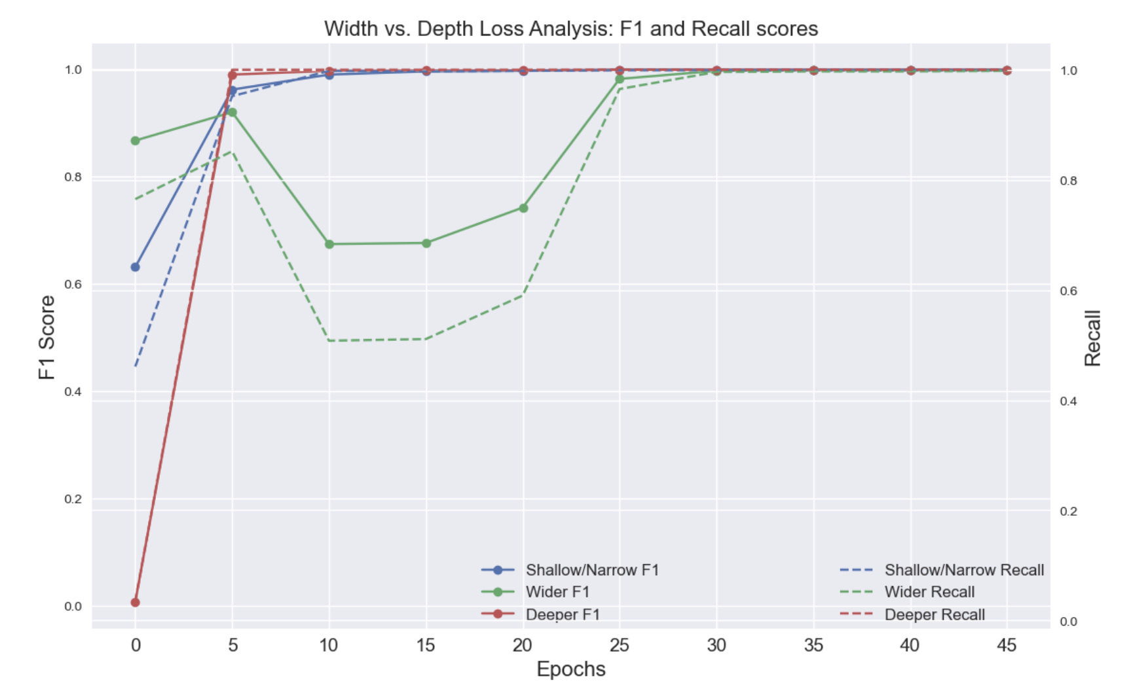

Slide 3
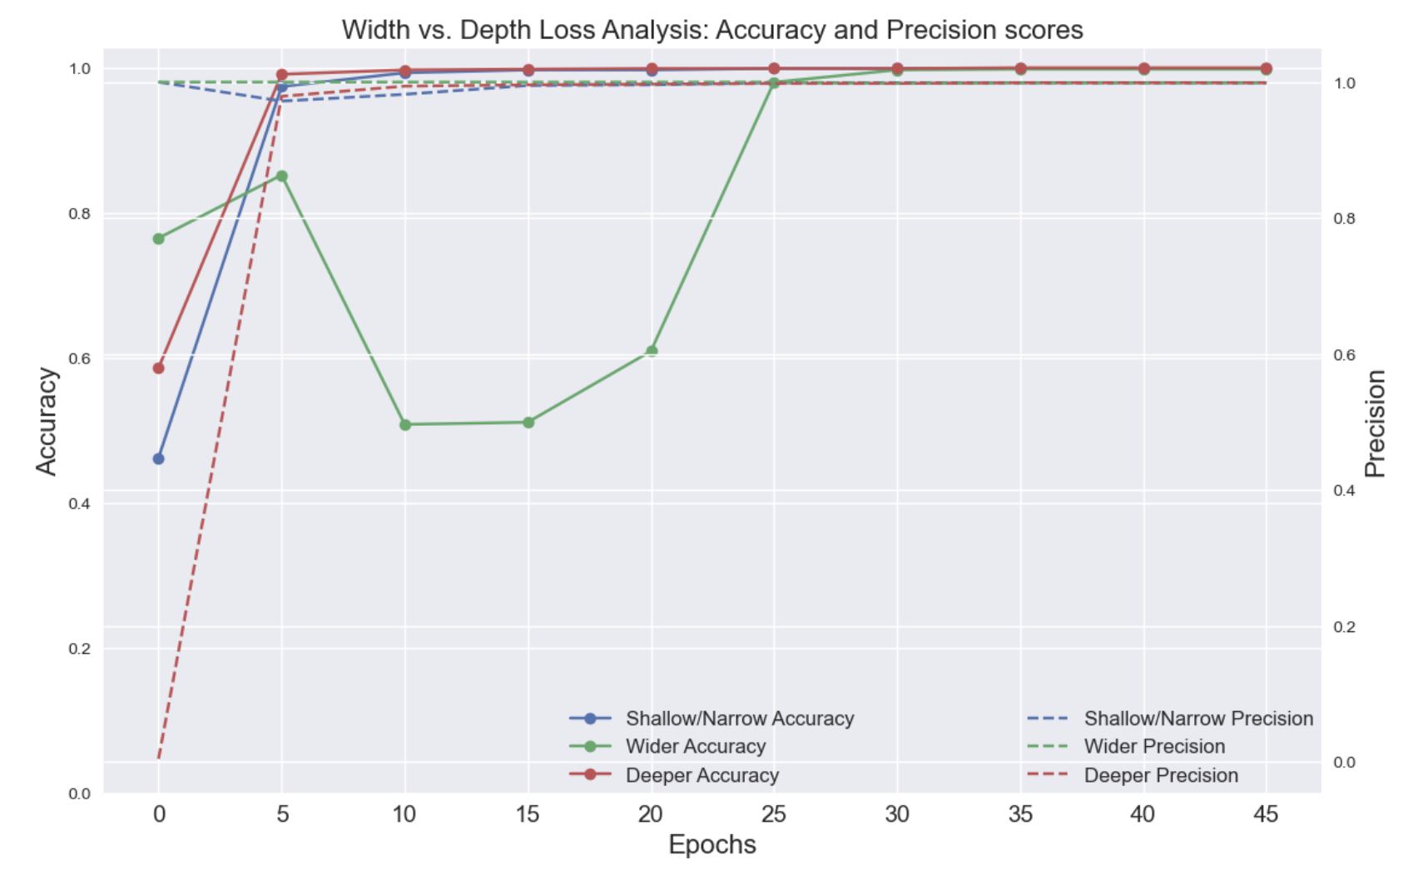

Slide 4
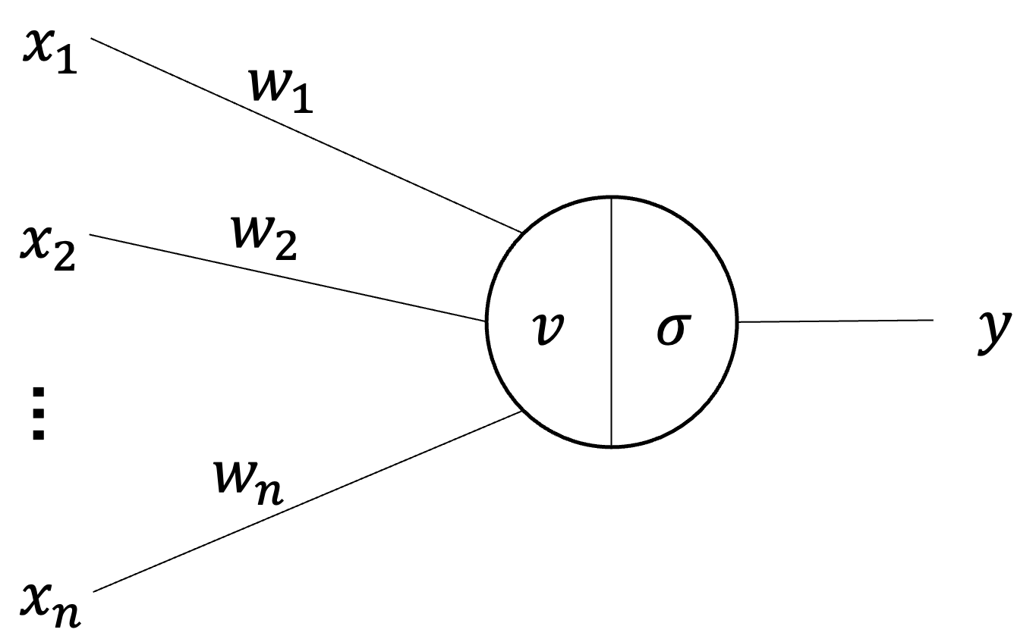
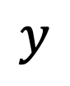
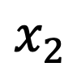
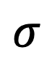
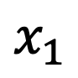
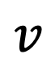
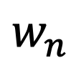
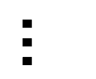
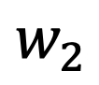
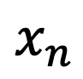
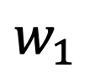
Input Layer
Hidden Layer
Output Layer
$$x_{1}$$
$$w_{1}$$
$$x_{2}$$
$$w_{2}$$
$$v$$
$$σ$$
$$y$$
$$…$$
$$w_{n}$$
$$x_{n}$$

Slide 5
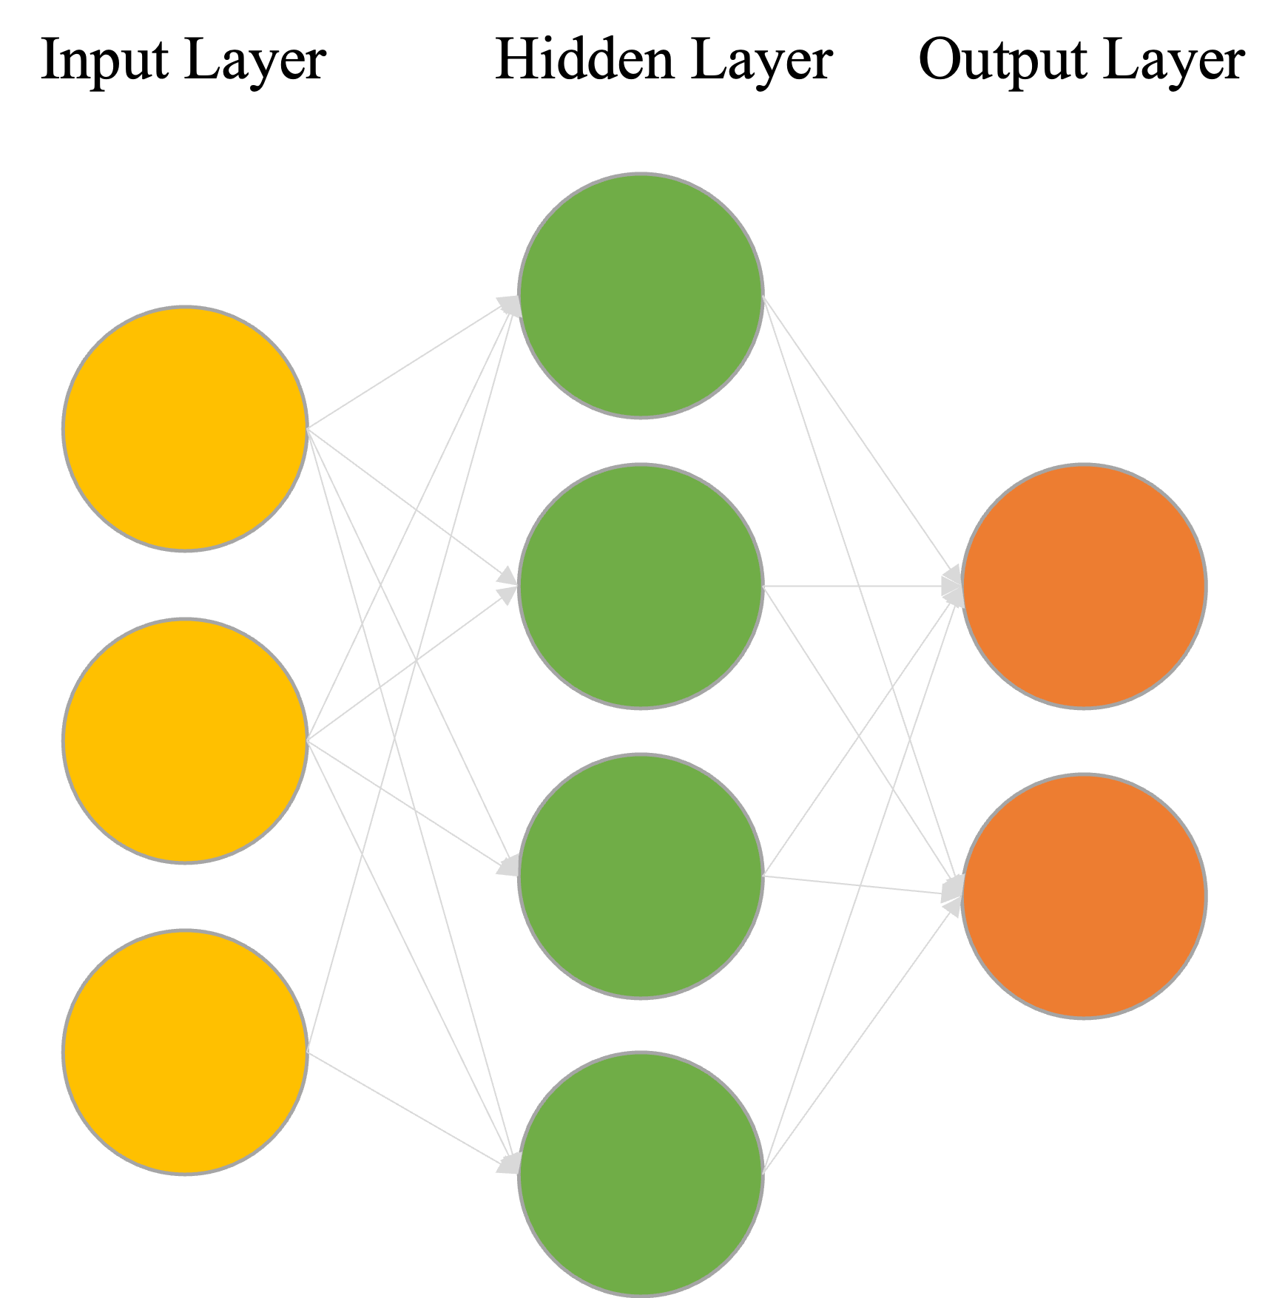
a.
b.

Slide 6
MNIST | Fashion MNIST | Label | One Hot Label
0 | T-shirt/top | 0 | [1, 0, 0, 0, 0, 0, 0, 0, 0, 0]
1 | Trouser | 1 | [0, 1, 0, 0, 0, 0, 0, 0, 0, 0]
2 | Pullover | 2 | [0, 0, 1, 0, 0, 0, 0, 0, 0, 0]
3 | Dress | 3 | [0, 0, 0, 1, 0, 0, 0, 0, 0, 0]
4 | Coat | 4 | [0, 0, 0, 0, 1, 0, 0, 0, 0, 0]
5 | Sandal | 5 | [0, 0, 0, 0, 0, 1, 0, 0, 0, 0]
6 | Shirt | 6 | [0, 0, 0, 0, 0, 0, 1, 0, 0, 0]
7 | Sneaker | 7 | [0, 0, 0, 0, 0, 0, 0, 1, 0, 0]
8 | Bag | 8 | [0, 0, 0, 0, 0, 0, 0, 0, 1, 0]
9 | Ankle Boot | 9 | [0, 0, 0, 0, 0, 0, 0, 0, 0, 1]

Slide 7
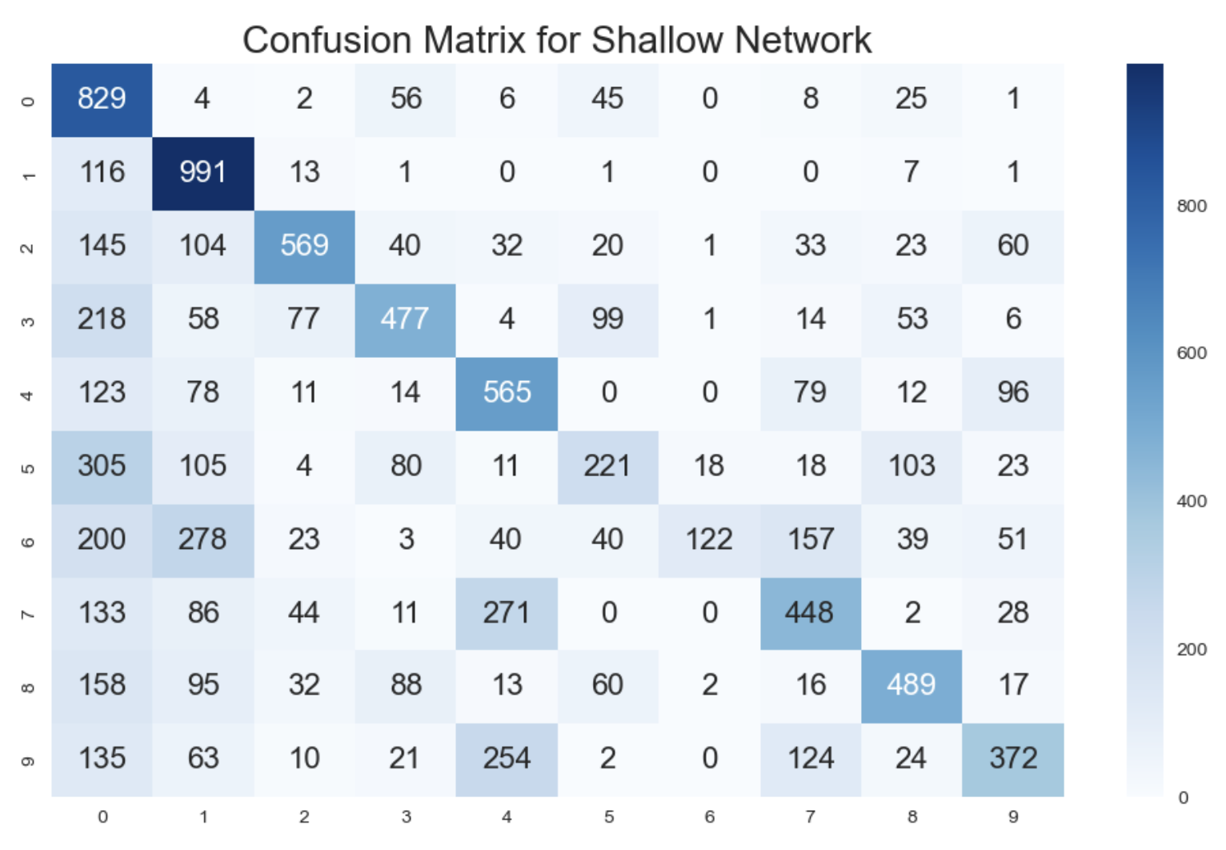
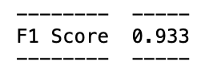

Slide 8
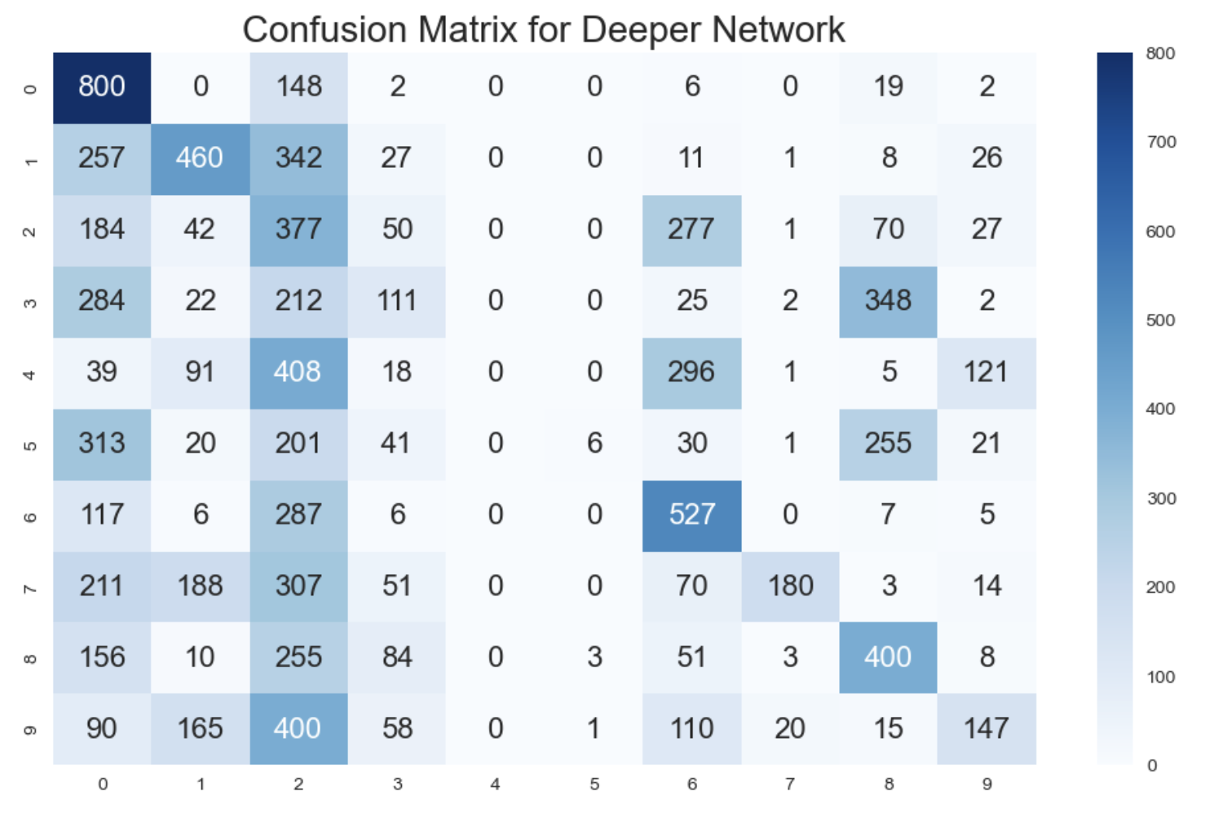
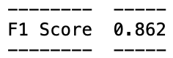

Slide 9
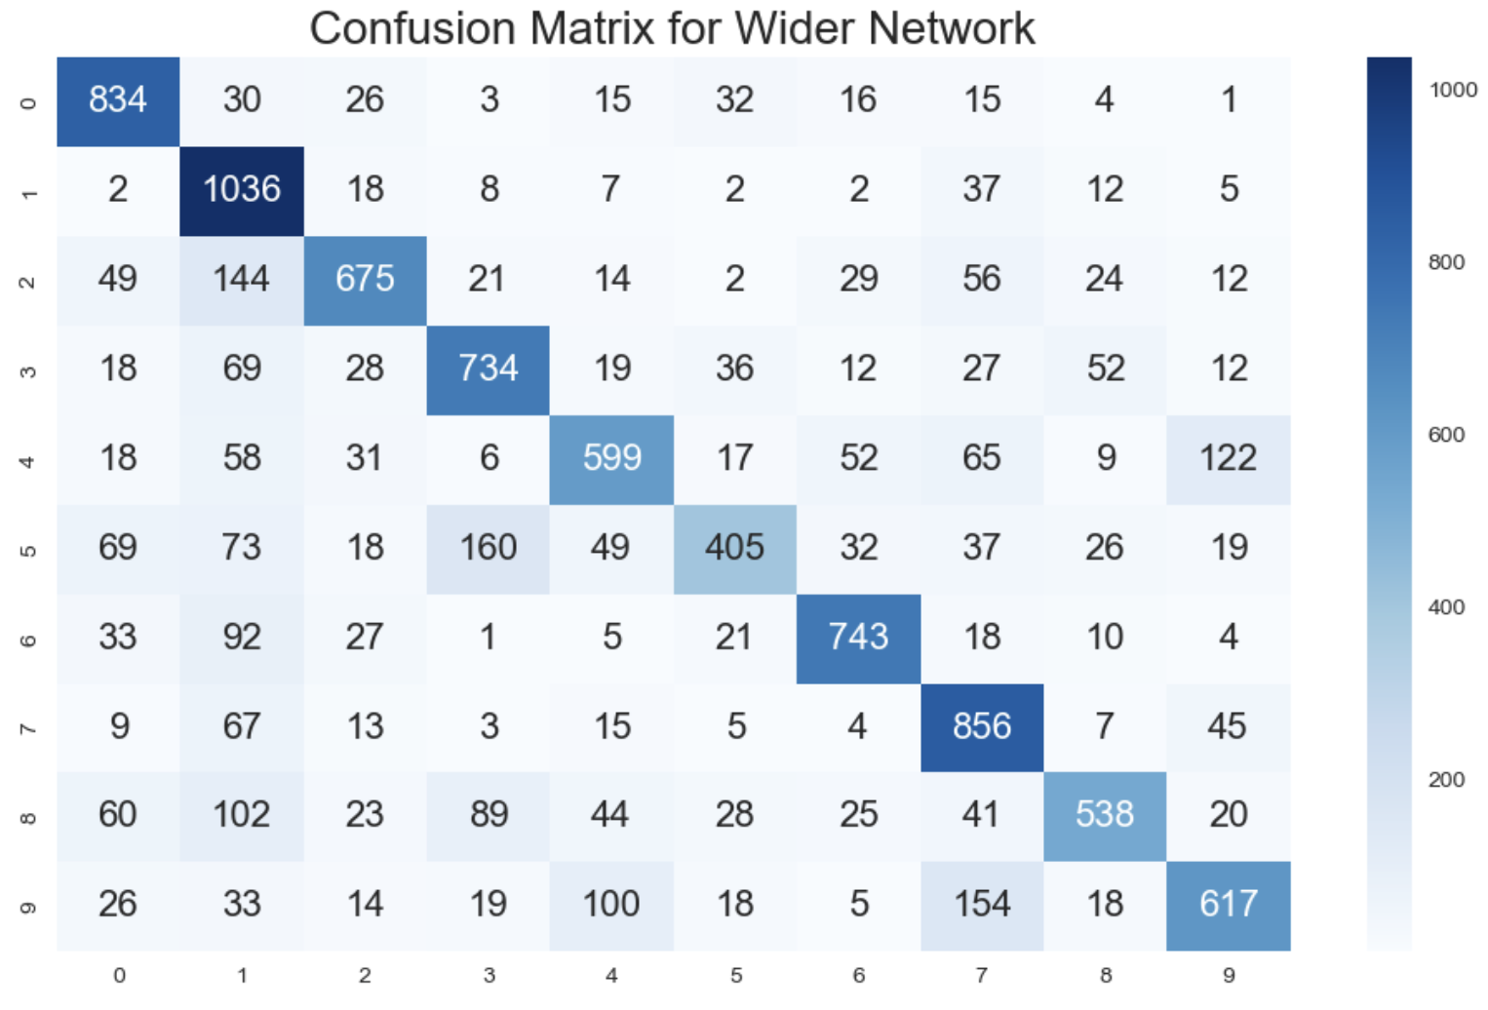
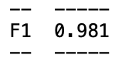

Slide 10
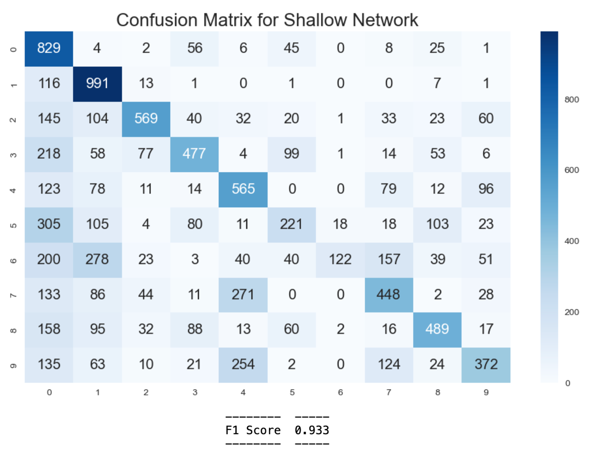
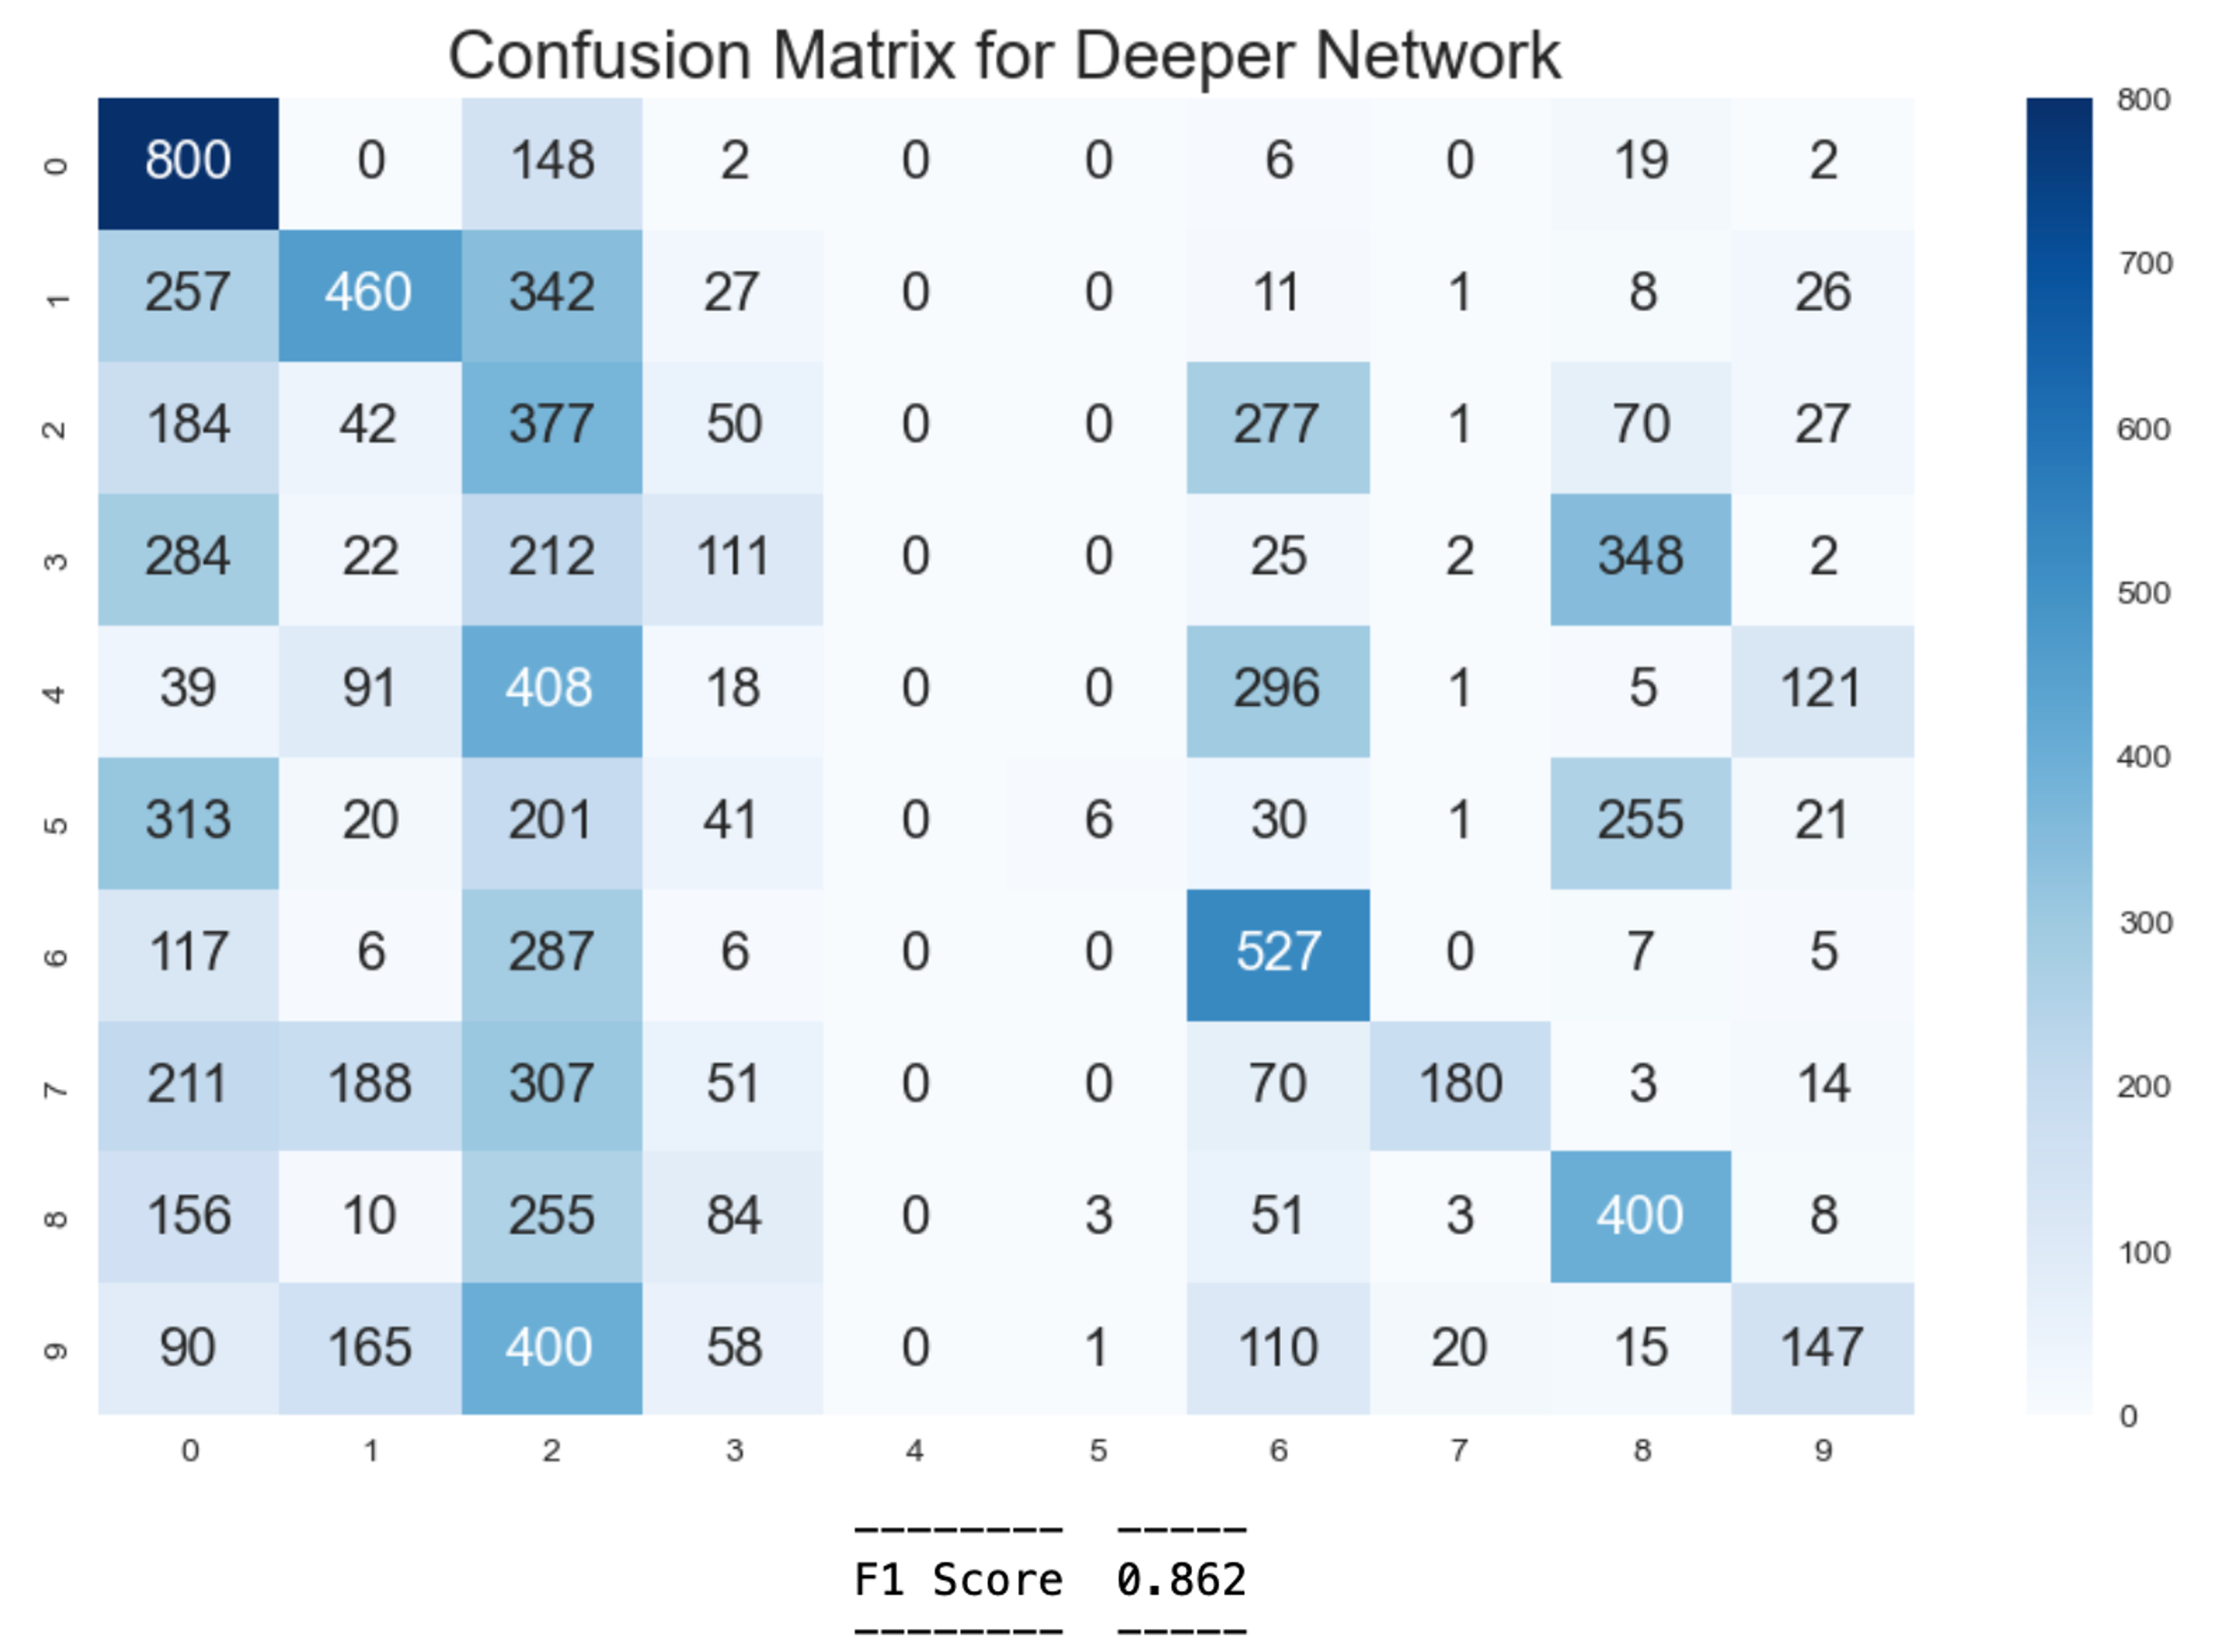
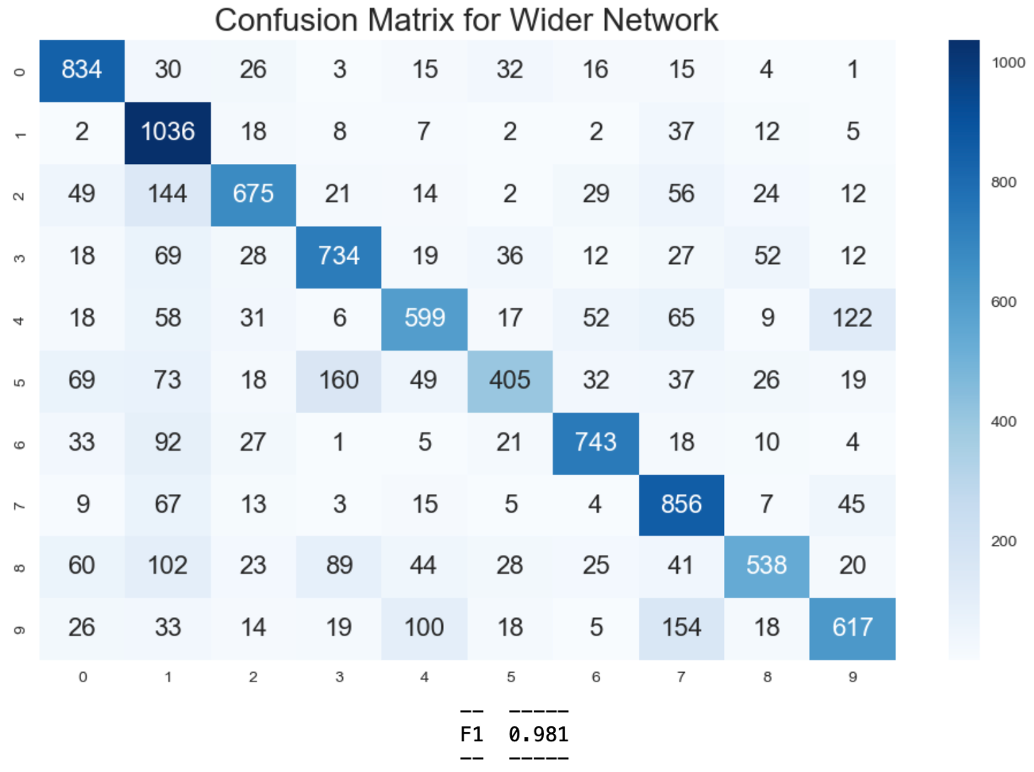

Slide 11
 | Experiment 1 (control) | Experiment 2 (depth) | Experiment 3 (width)
# layers | 3 | 4 | 3
# neurons in layer 1 | 64 | 64 | 512

Slide 12
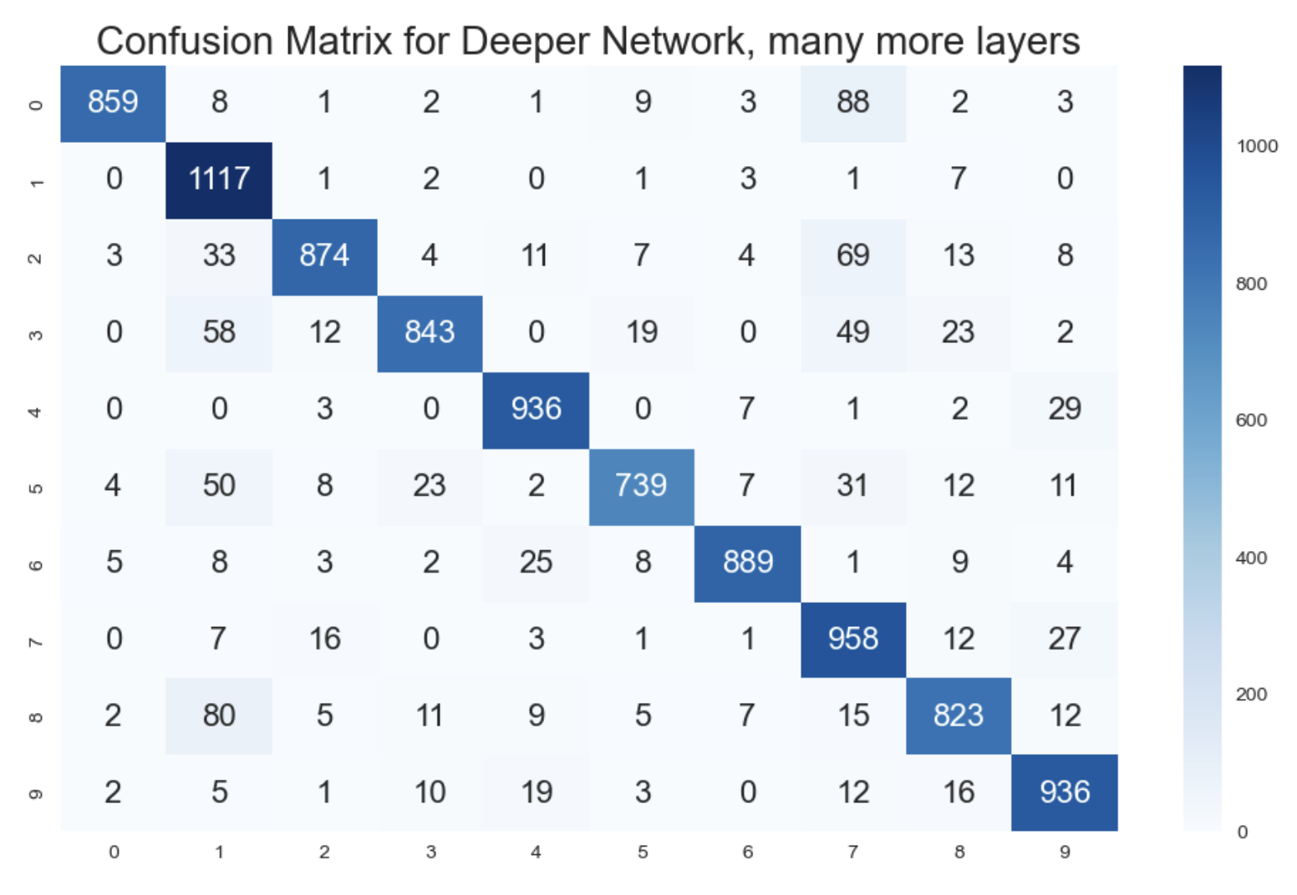
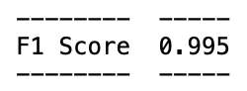

Slide 13
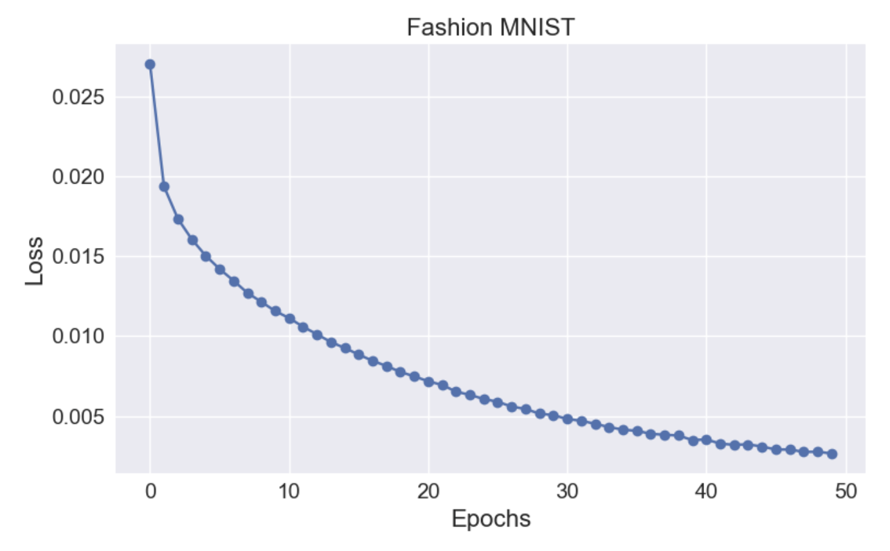
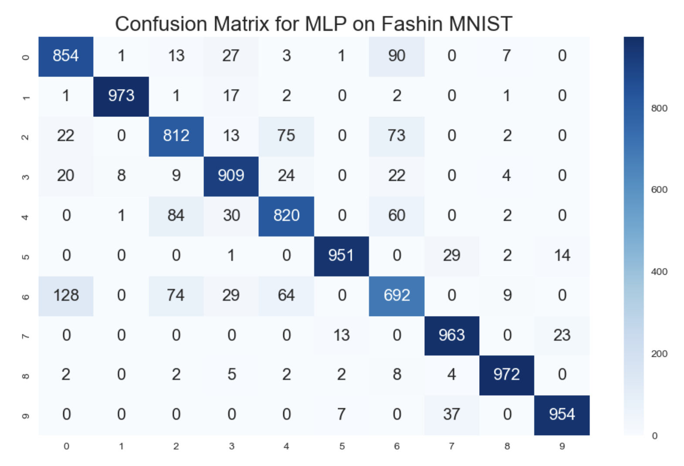
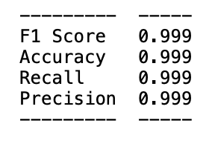

Slide 14
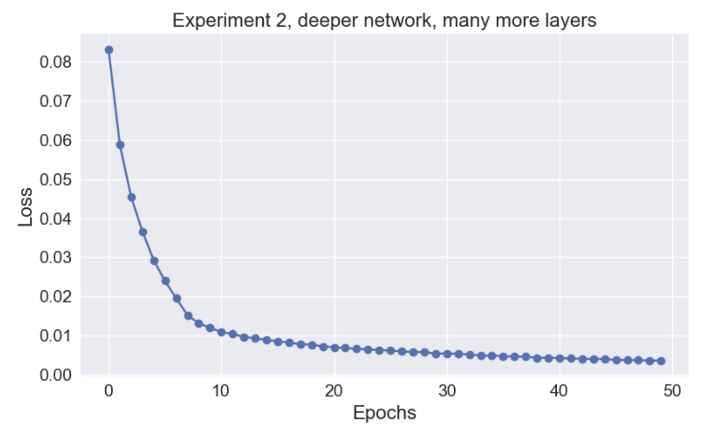
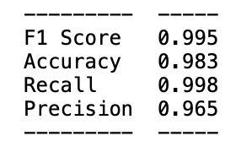

Slide 15
CNNs
Accepts 2d input
Goal is to locate features (really just combinations of pixels)
Window == kernel
First layer: Edges, curves, corners
Second layer: more complex things, circles, squares
Third layer: finds combinations of circles, squares, etc
Reduce image to basic building blocks and find patterns within those building blocks

Slide 16
Input image
NxN pixels
Fully connected layer
convolution
pooling
output
Hidden Layer
This makes up a single hidden layer
Create feature maps
Usually max pooling
Typically an MLP

Slide 17

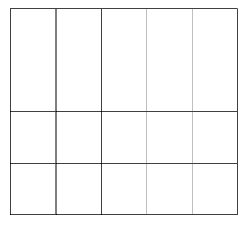
This is the convolution operation with 3x3 kernels (windows) basically condenses the image. Finds features

Slide 18
Convolution gives us a feature map. Now how do we do pooling? Think of the scalar values as features.
1 | 5 | 4 | 1 | 0
2 | 3 | 1 | 3 | 2
0 | 4 | 2 | 3 | 4
0 | 2 | 4 | 3 | 2
5
4
4
4
Convolution + Pool = Hidden Layer

Slide 19
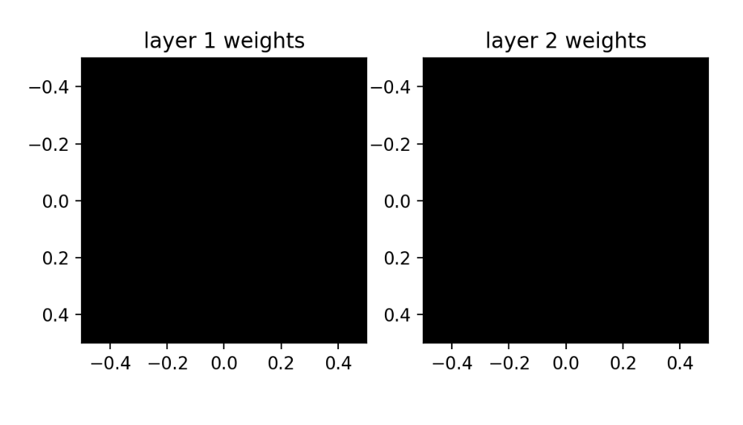
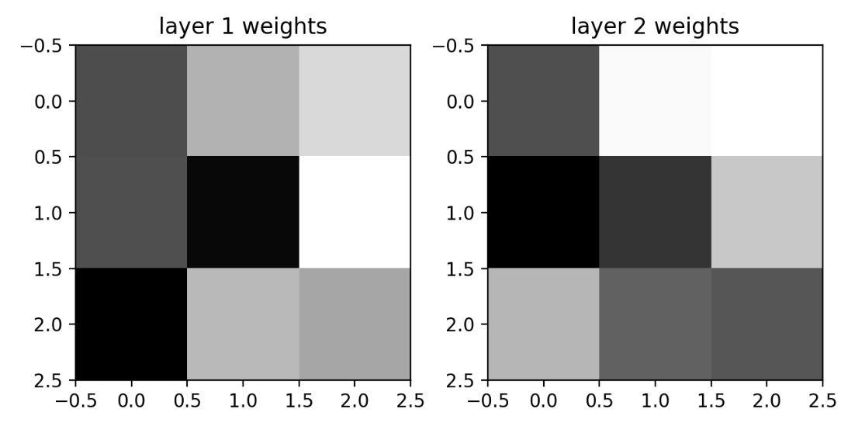
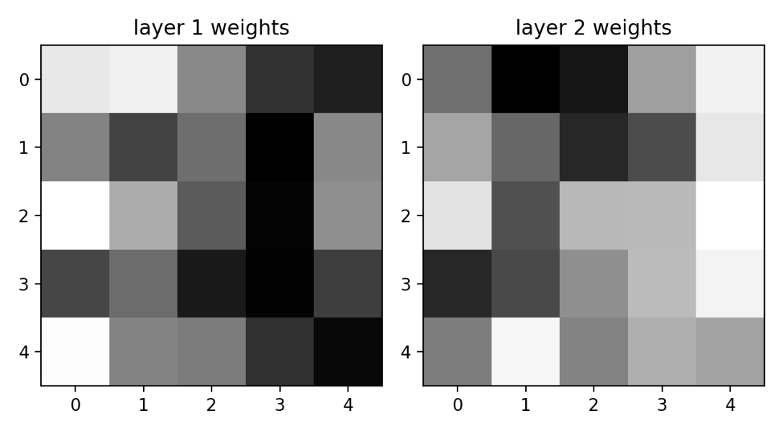
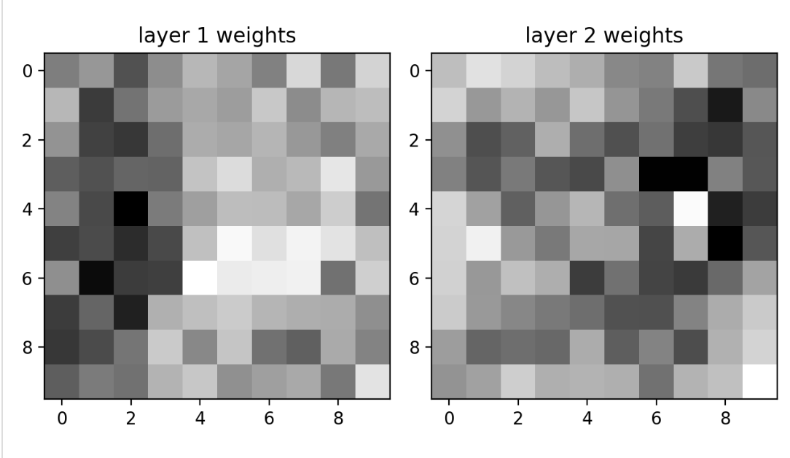

Slide 20
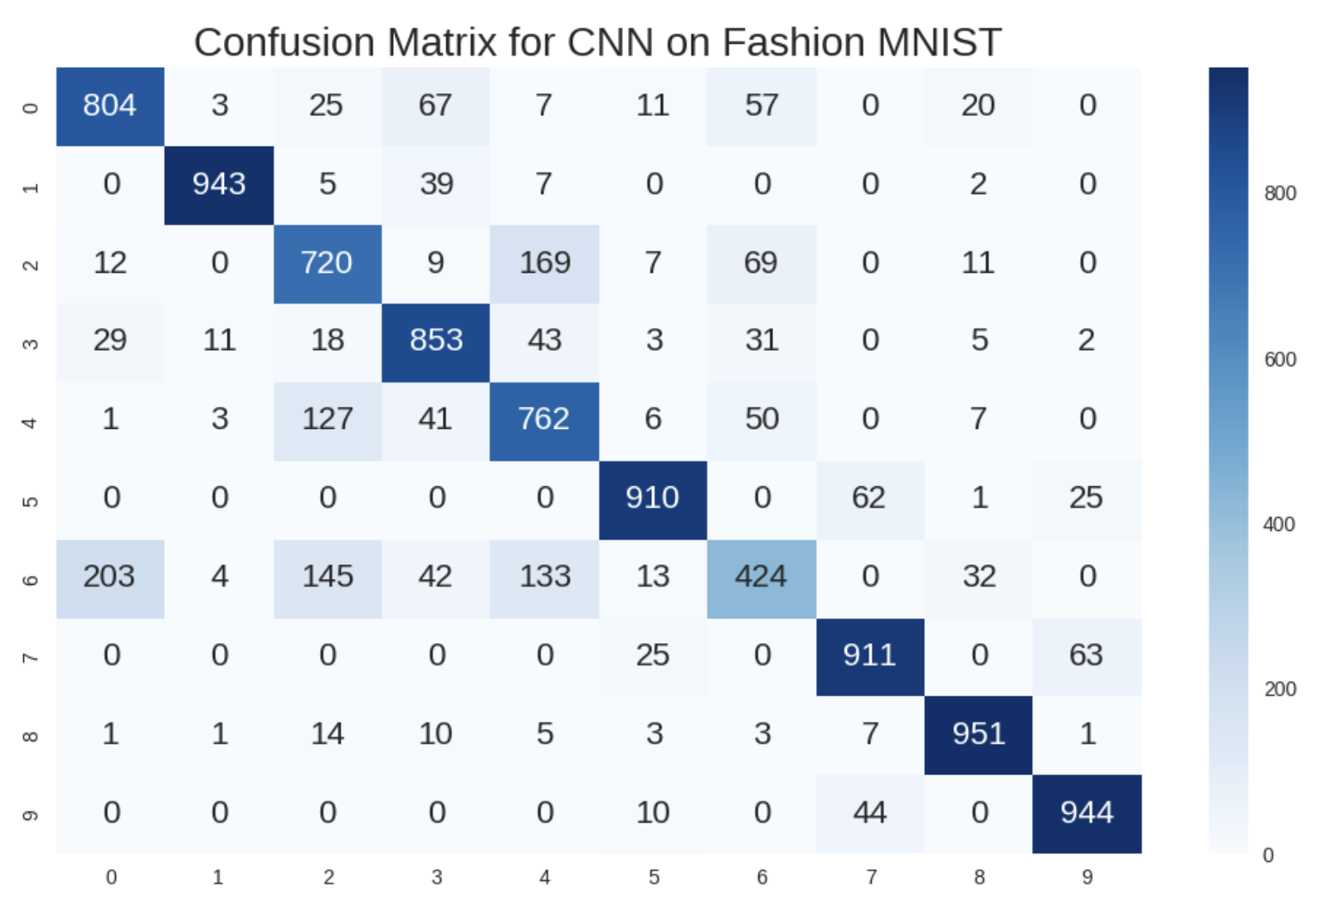
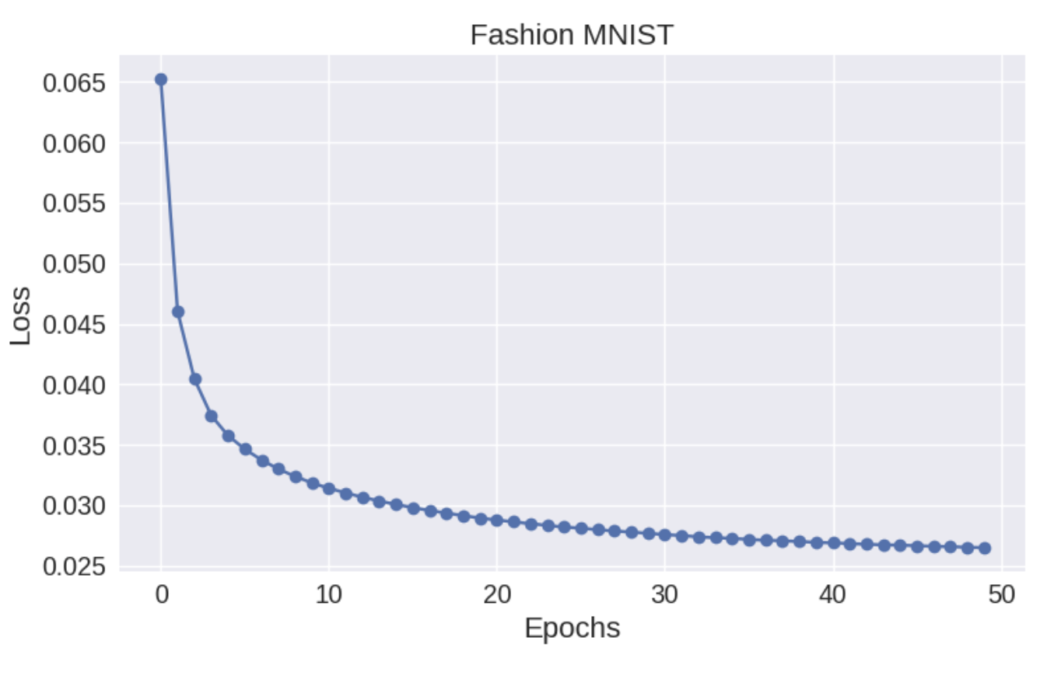
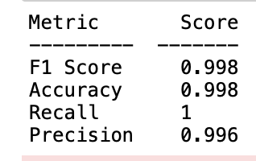

Slide 21
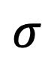
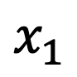
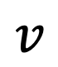
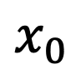
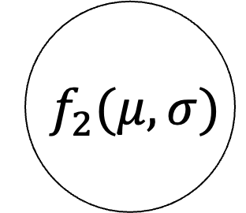
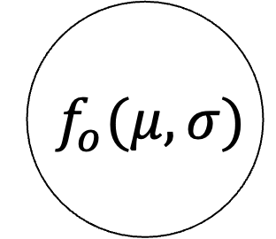
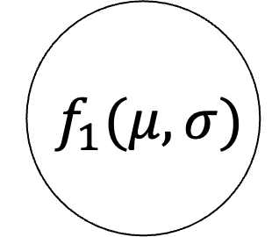
x₀
$${ f}_{o}(μ,σ)$$
Input image
NxN pixels
$$x_{0}$$
$${ f}_{1}(μ,σ)$$
convolution
pooling
output
$$v$$
$$σ$$
x₁
$$x_{1}$$
$${ f}_{2}(μ,σ)$$
Fully connected layer
Hidden Layer
This makes up a single hidden layer
Typically an MLP

